Slide 1
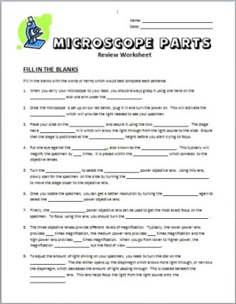
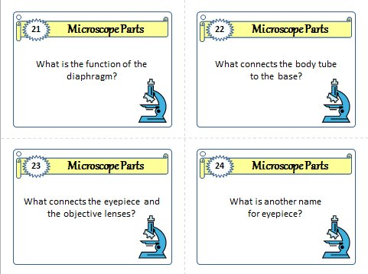
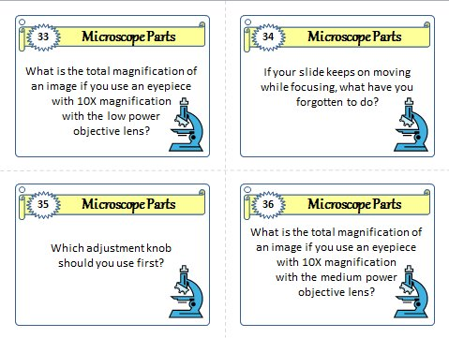
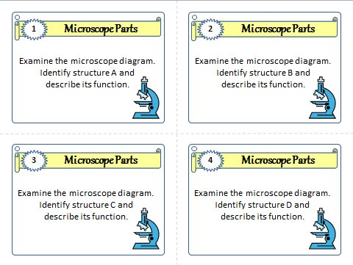
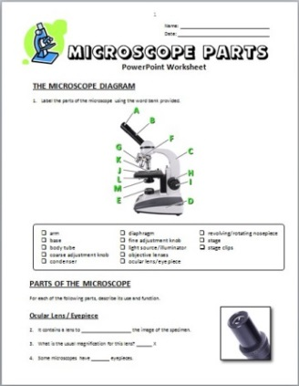
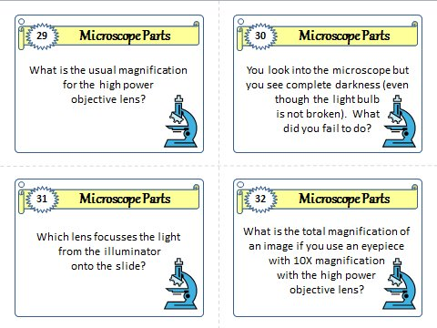
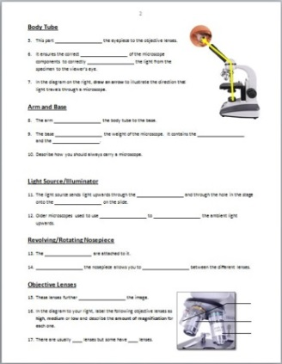
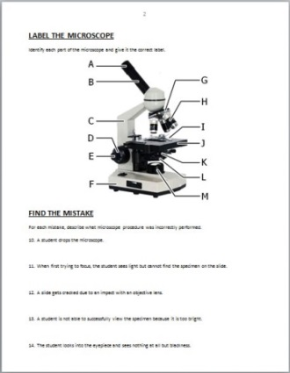
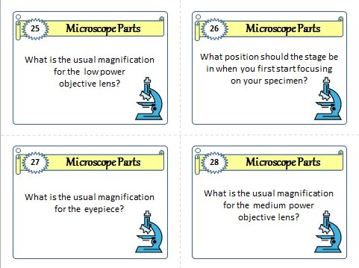
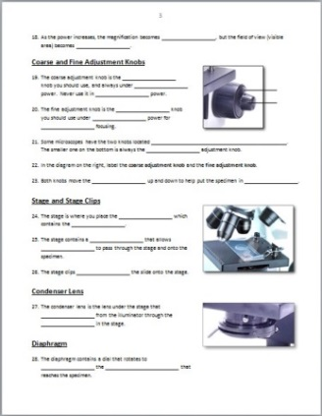
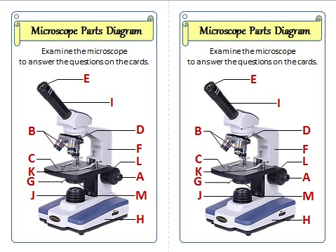
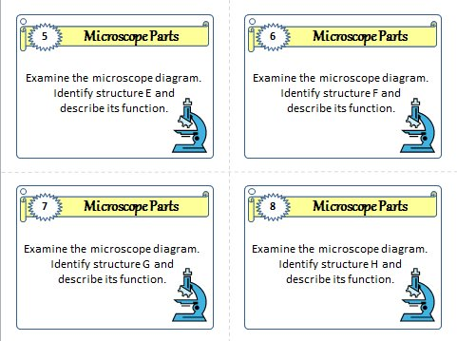
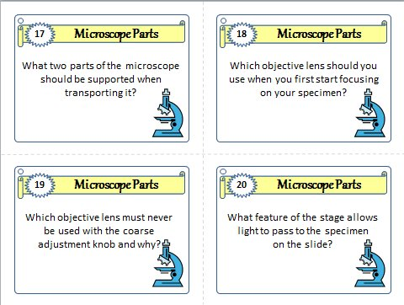
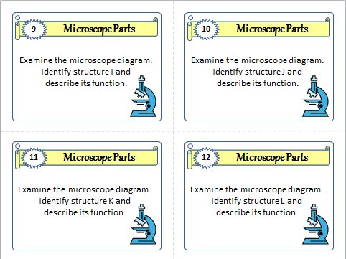
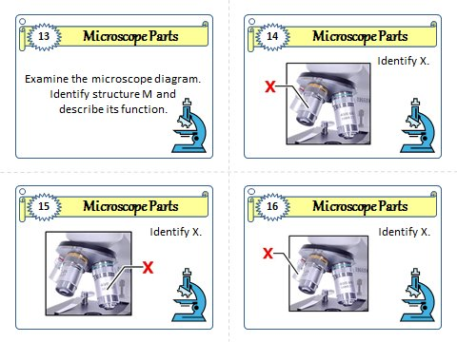
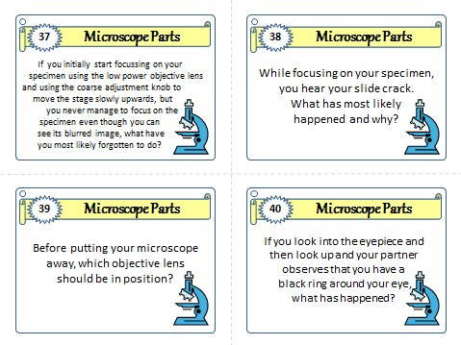
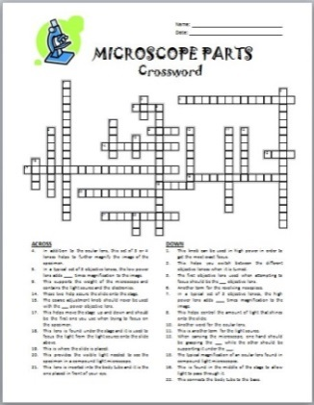
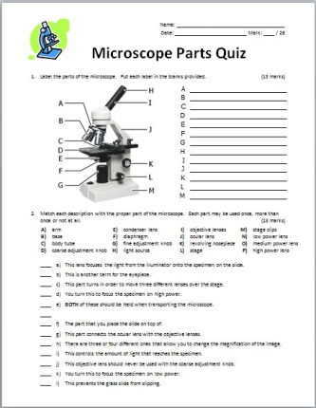
Please enjoy this FREE Microscope Parts PowerPoint.
Resources (with answer keys) for the Microscope Parts PowerPoint
can be found at my TPT store and can be purchased separately…..
Review
Worksheet
PowerPoint
Worksheet
Task Cards
Crossword
Quiz

Slide 2
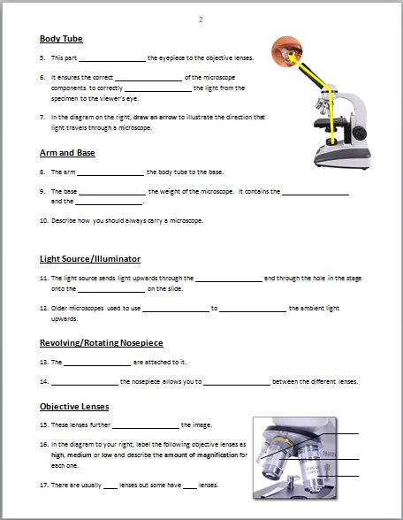
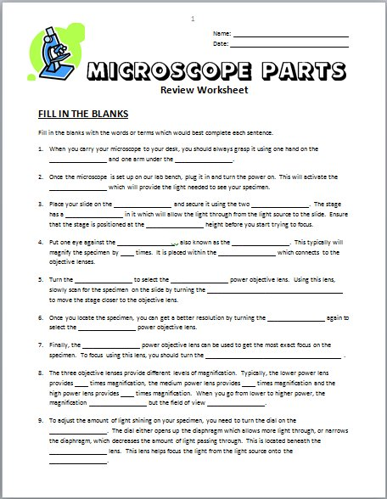
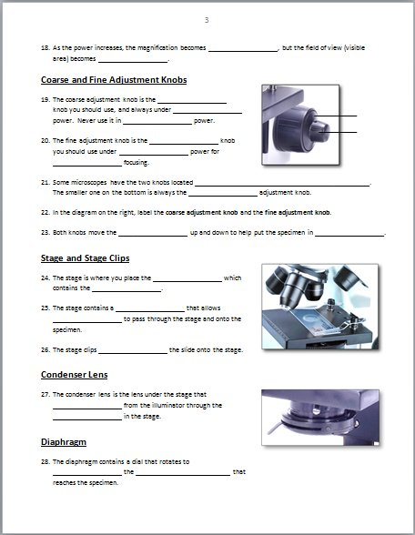
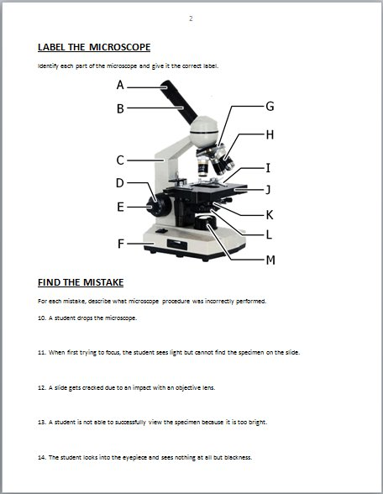
Please enjoy this FREE Microscope Parts PowerPoint.
….or purchased all together as a LESSON BUNDLE, at 25% OFF.
1) 3 page PowerPoint Worksheet
2) 2 page Review Worksheet
3) 1 Crossword
4) 40 Task Cards
5) 1 Quiz

Slide 3
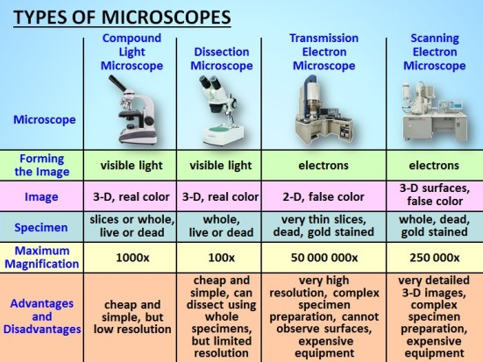
Please enjoy this FREE Microscope Parts PowerPoint.
If you would like to purchase the more
ADVANCED MICROSCOPE POWERPOINT LESSON,
it includes 31 more slides on these additional topics:
1) The Function of Microscopes.
2) The History of Microscope Development.
3) A Comparison of 4 Microscope types in a Chart as well
as examples of the images produced. (Compound light
microscope, dissecting microscope, SEM and TEM.)
4) How to Calculate Magnification.
5) How to Make a Wet Mount (includes video).

Slide 4
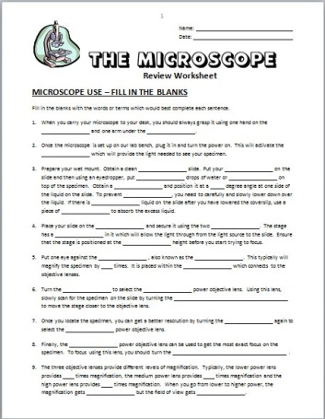
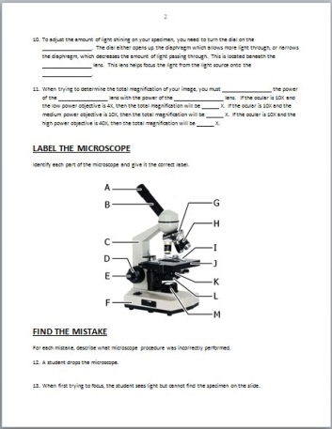
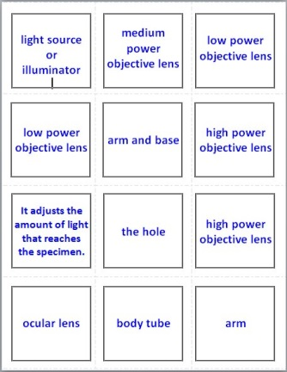
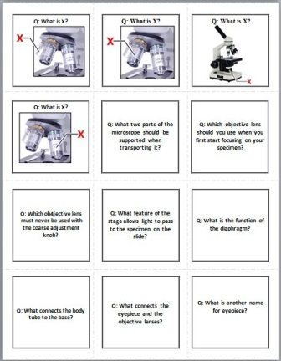
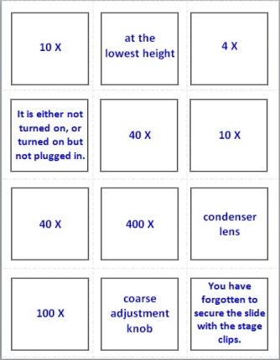
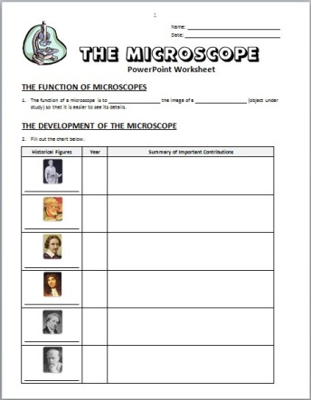
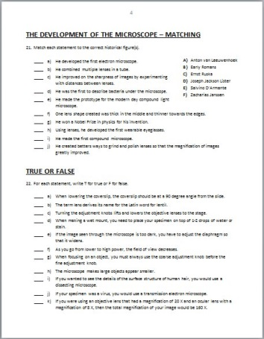
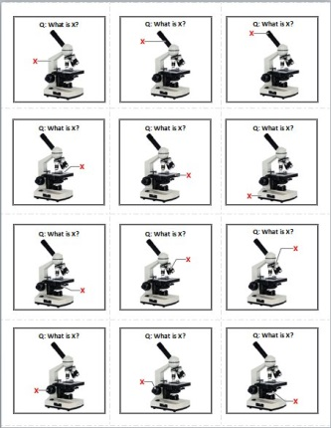
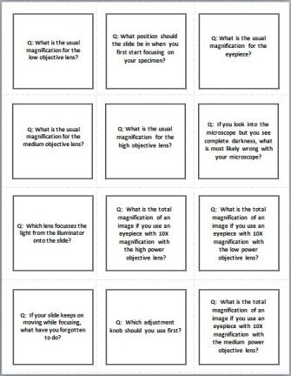
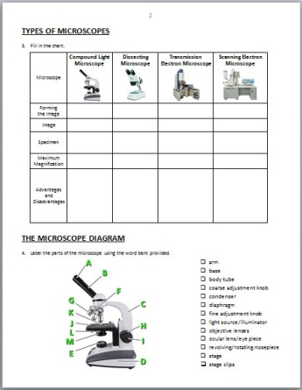
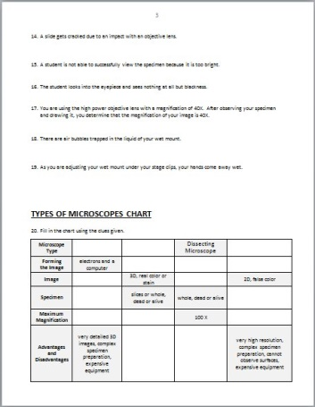
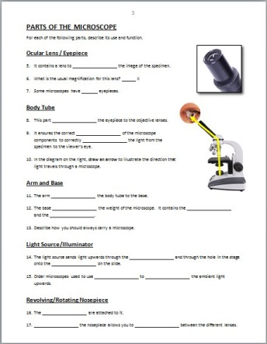
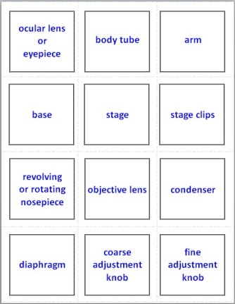
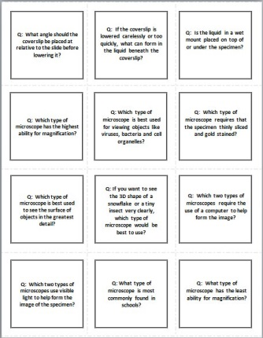
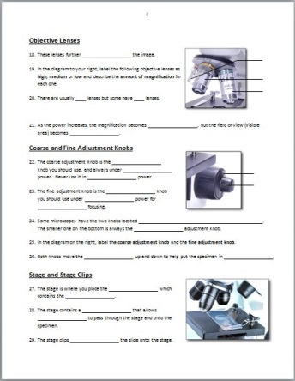
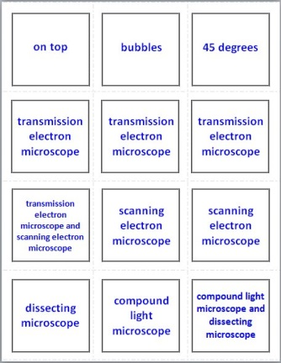
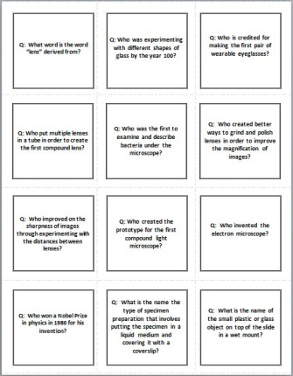
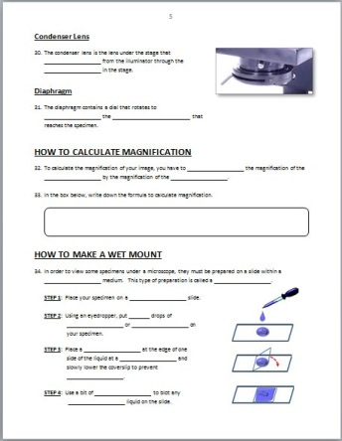
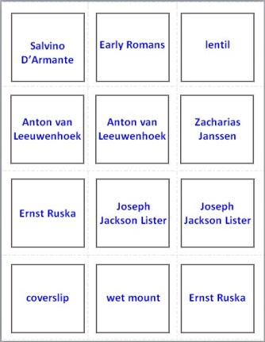
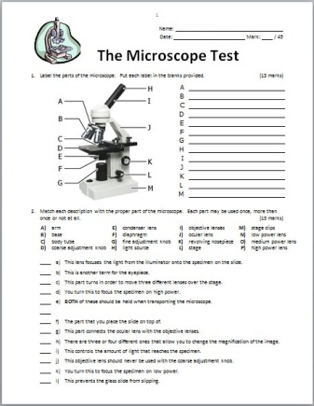
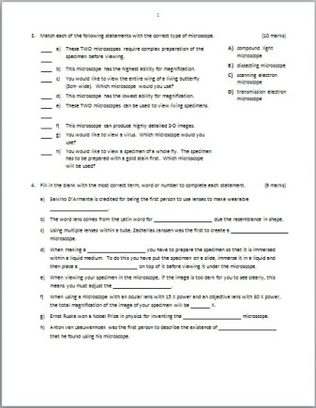
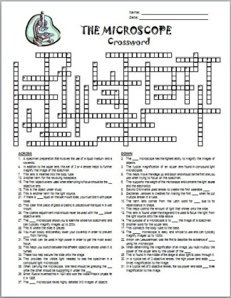
Please enjoy this FREE Microscope Parts PowerPoint.
If you would like to purchase the more
ADVANCED MICROSCOPE POWERPOINT LESSON,
it includes 31 more slides on these additional topics:
Flash Cards
Review
Worksheet
PowerPoint
Worksheet
Test
Crossword
The Advanced PowerPoint also comes with resources that can be
purchased separately or as a LESSON BUNDLE for 25% OFF.

Slide 5
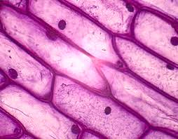
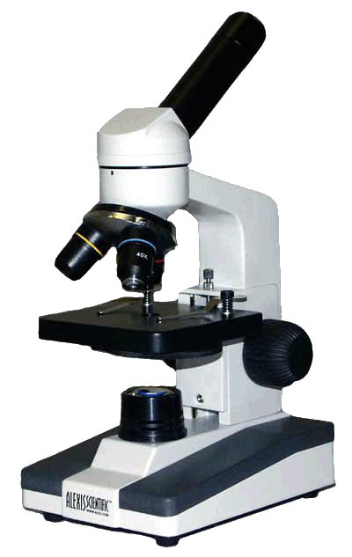
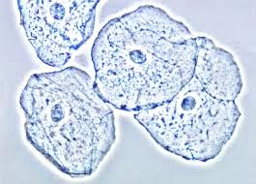
MICROSCOPE PARTS

Slide 6
CONCEPTS EXPLORED IN THIS LESSON
ocular lens / eyepiece
body tube
arm
base
light source/illuminator
revolving/rotating nosepiece
objective lenses
coarse adjustment knob
fine adjustment knob
stage
stage clips
condenser lens
diaphragm

Slide 7
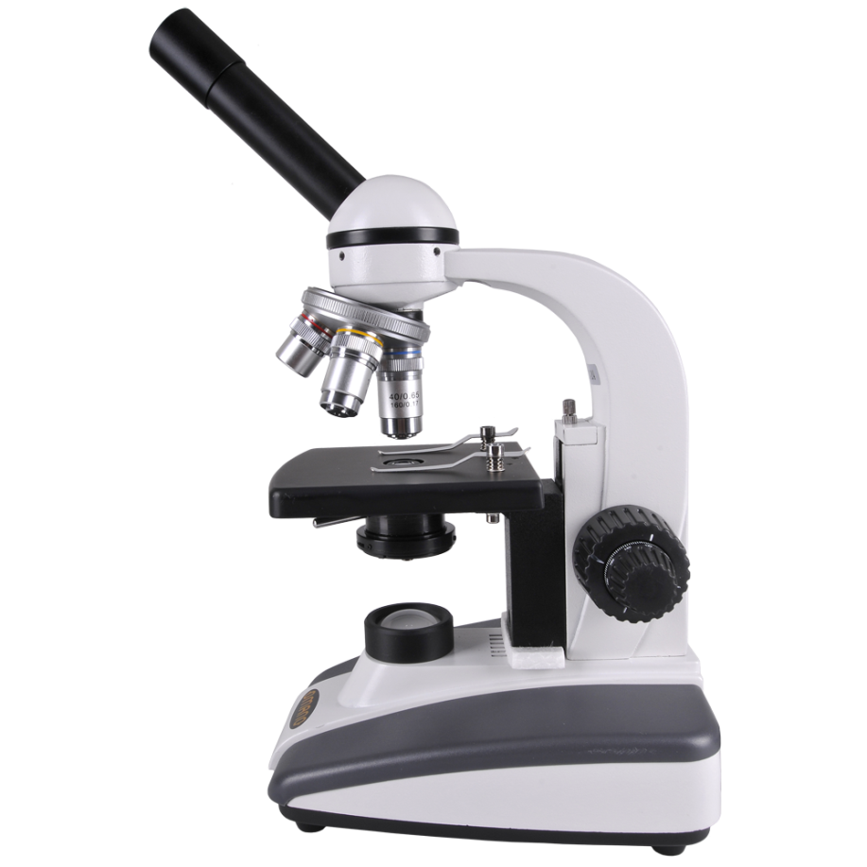
PARTS OF THE COMPOUND LIGHT MICROSCOPE
Do you know some of these parts?
Label as many parts as you can using the terms provided.
revolving nosepiece
A
B
arm
diaphragm
F
ocular lens / eyepiece
condenser
G
C
objective lenses
K
stage clips
body tube
J
H
base
L
I
light source / illuminator
M
coarse adjustment knob
D
E
stage
fine adjustment knob

Slide 8
PARTS OF THE COMPOUND LIGHT MICROSCOPE
Did your labels look something like this?
A
ocular lens/eyepiece
B
body tube
F
revolving/rotating nosepiece
objective lenses
G
C
arm
stage clips
K
stage
J
H
coarse adjustment knob
condenser
L
I
fine adjustment knob
diaphragm
M
light source/
illuminator
E
D
base

Slide 9
PARTS OF THE COMPOUND LIGHT MICROSCOPE
Ocular Lens / Eyepiece
A
magnify
Contains a lens to _______ the image of the specimen.
10
The usual magnification is ___ X.

Slide 10
PARTS OF THE COMPOUND LIGHT MICROSCOPE
Ocular Lens / Eyepiece
A
magnify
Contains a lens to _______ the image of the specimen.
10
The usual magnification is ___ X.
two
Some microscopes have ___ ocular lenses.

Slide 11
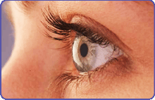
PARTS OF THE COMPOUND LIGHT MICROSCOPE
Body Tube
B
connects
It ________ the eyepiece to the objective lenses.
alignment
It ensures the correct ________ of the microscope components
to correctly _____ the light from the specimen into the viewer’s eye.
direct

Slide 12
PARTS OF THE COMPOUND LIGHT MICROSCOPE
Arm
C
connects
It ________ the body tube to the base.
hand
One ____ should be around the arm when _______ the microscope
carrying
(the other should be under the ____).
base

Slide 13
PARTS OF THE COMPOUND LIGHT MICROSCOPE
Arm
C
connects
It ________ the body tube to the base.
hand
One ____ should be around the arm when _______ the microscope
carrying
(the other should be under the ____).
base

Slide 14
PARTS OF THE COMPOUND LIGHT MICROSCOPE
Base
It ________ the weight of the microscope.
supports
electronics
light source
It contains the _________ and __________.
D
under
One hand should be _____ the base while _______ the microscope
carrying
(the other hand should be holding the arm).

Slide 15
PARTS OF THE COMPOUND LIGHT MICROSCOPE
Base
It ________ the weight of the microscope.
supports
electronics
light source
It contains the _________ and __________.
D
under
One hand should be _____ the base while _______ the microscope
carrying
(the other hand should be holding the arm).

Slide 16
PARTS OF THE COMPOUND LIGHT MICROSCOPE
Light Source / Illuminator
upwards
It sends light _______ through the _____________
condenser lens
hole
E
and through the ____ in the stage
specimen
onto the ________ on the slide.

Slide 17
PARTS OF THE COMPOUND LIGHT MICROSCOPE
Light Source / Illuminator
mirror
upwards
It sends light _______ through the _____________
condenser lens
hole
E
and through the ____ in the stage
specimen
onto the ________ on the slide.
mirrors
Older microscopes used to use ______ to ______ the ambient light upwards.
reflect

Slide 18
PARTS OF THE COMPOUND LIGHT MICROSCOPE
Revolving/Rotating Nose Piece
F
objective lenses
The _____________ are attached to it.
Rotating
_______ the nose piece allows you to _____ between the different lenses.
switch

Slide 19
PARTS OF THE COMPOUND LIGHT MICROSCOPE
Objective Lenses
Low (scanning)
4 X
Medium
10 X
G
High
40 X
magnify
These lenses further _______ the image of the specimen.
4 X
10 X
The magnifications are usually ___ , ____ and ____ .
40 X
3
There are usually __ lenses

Slide 20
PARTS OF THE COMPOUND LIGHT MICROSCOPE
Objective Lenses
G
magnify
These lenses further _______ the image of the specimen.
4 X
10 X
The magnifications are usually ___ , ____ and ____ .
40 X
3
There are usually __ lenses
but some have __ lenses.
4

Slide 21
PARTS OF THE COMPOUND LIGHT MICROSCOPE
Objective Lenses
Low
Medium
High
G
As the power increases, the magnification becomes _____ ,
larger
but the field of view (visible area) becomes _______.
smaller

Slide 22
PARTS OF THE COMPOUND LIGHT MICROSCOPE
Coarse Adjustment Knob
H
first
The ____ knob you should use, and always under ___ power.
low
high
Never use it in ____ power.

Slide 23
PARTS OF THE COMPOUND LIGHT MICROSCOPE
Fine Adjustment Knob
H
I
first
The ____ knob you should use, and always under ___ power.
low
high
Never use it in ____ power.
second
The ______ knob you should use under ______ power
higher
exact
for _____ focusing.
stage
Both knobs move the _____ up and down
focus
to help put the specimen in _____.

Slide 24
PARTS OF THE COMPOUND LIGHT MICROSCOPE
Fine Adjustment Knob
H
I
Some microscopes have the two knobs located ___________________.
one on top of the other
The smaller one on the bottom is always the ____ adjustment knob.
fine

Slide 25
PARTS OF THE COMPOUND LIGHT MICROSCOPE
Stage
J
slide
The stage is where you place the ____ which contains the ________.
specimen
hole
It contains a ____ that allows ____ to pass through the stage and onto the specimen.
light

Slide 26
PARTS OF THE COMPOUND LIGHT MICROSCOPE
Stage Clips
K
J
slide
The stage is where you place the ____ which contains the ________.
specimen
hole
It contains a ____ that allows ____ to pass through the stage and onto the specimen.
light
secure
The stage clips ______ the slide on the stage.

Slide 27
PARTS OF THE COMPOUND LIGHT MICROSCOPE
Condenser Lens
L
The lens under the stage that ___________ from the illuminator through to the ____ in the stage.
focuses light
hole

Slide 28
PARTS OF THE COMPOUND LIGHT MICROSCOPE
Diaphragm
L
The lens under the stage that ___________ from the illuminator through to the ____ in the stage.
focuses light
M
hole
adjust
It contains a dial that rotates to _____ the _____________ that reaches the specimen.
amount of light

Slide 29
The End!

Slide 30
Created by Anh-Thi Tang – Tangstar Science
Copyright © August 2014 Anh-Thi Tang (a.k.a. Tangstar Science)
All rights reserved by author.
This document is for personal classroom use only.
This entire document, or any parts within, may not be electronically distributed or posted to any website including teacher or classroom blogs or websites.
http://www.teacherspayteachers.com/Store/Tangstar-Science

