Slide 1
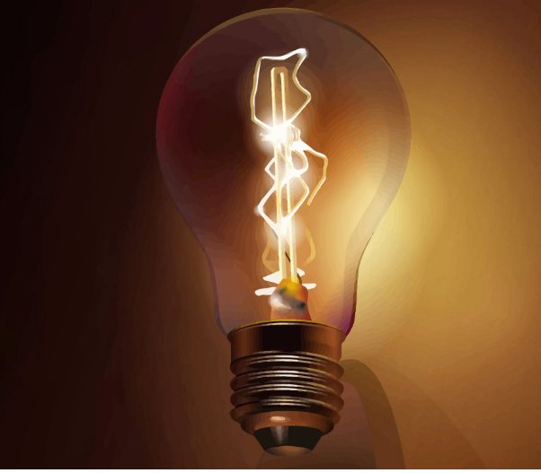
Twin Oaks Elementary Science Docent Grade 4 Electricity

Slide 2
Science Lab Rules
Please do not touch materials until instructed to do so
Please do not touch the band instruments or supplies
Never put any instruments or materials (liquid or solid) in your mouth, eyes, or ears. Or in the mouth, eyes, or ears of any student
Take turns
Listen carefully to the docent’s directions before beginning
Handle all materials carefully
Relax and have fun

Slide 3
What Is Electricity?
A form of energy that can give things the ability to move and work.
Examples of how we use electricity
How often do we use electricity?
Notes:
Who can give me an example of how we use electricity?
It powers our lights, charges our electronic devices (tablets, phones, computers), and helps keep us warm and cool.
How often do we use electricity?
Webster Dictionary definition: A fundamental form of energy observable in positive and negative forms that occurs naturally (as in lightning) or is produced (as in generator) and that is expressed in terms of movement and interaction of electrons.
Electricity is a type of energy that comes from the flow of electrical power, also known as a charge. Electricity is used to power our homes, lights and electronics. We get electricity from sources like coal, energy, natural gas and oil.

Slide 4
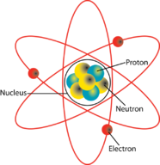
Electrons
Everything in the world around us is made of atoms.
Atoms are made up of particles called protons, neutrons and electrons.
When the electrons move from one atom to another, they produce electricity.

Slide 5
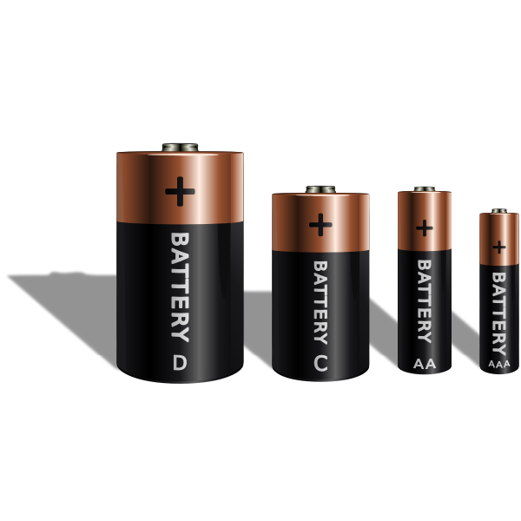
Electric Current
There are two types of electric current
Direct current and
Alternating current
Batteries and solar cells provide direct current and have a positive and a negative side.
The power flows in a loop/in one direction from the positive side to the negative side.

Slide 6
Conductors and Insulators
Electrical conductors are materials that allow electricity to pass through them easily.
Examples of conductors?
Electrical insulators are materials that do not allow electricity to pass through them.
Examples of insulators?
Safety
Notes:
Materials that allow electricity to pass through them easily are called electrical conductors.
Who can name a conductor?
Examples of these materials include many metals, such as iron, steel, copper, and aluminum.
Materials that do not allow electricity to pass through them are called electrical insulators.
Who can name an insulator?
Examples of these materials include plastic, rubber, wood, and glass. Air is also an insulator. Most electrical objects are made using insulators to keep them safe.

Slide 7
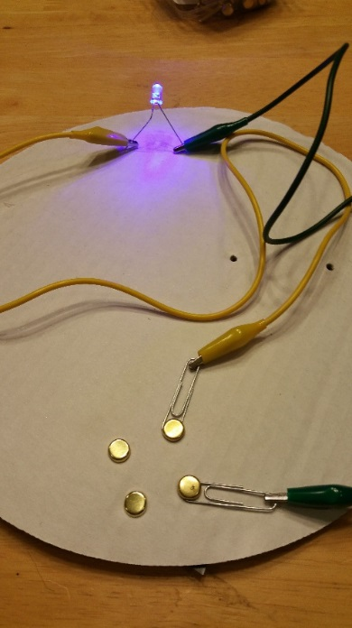
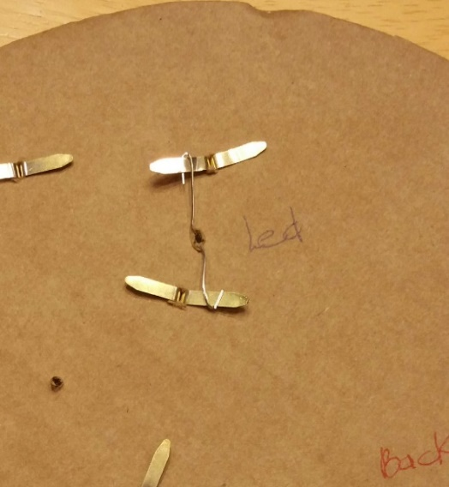
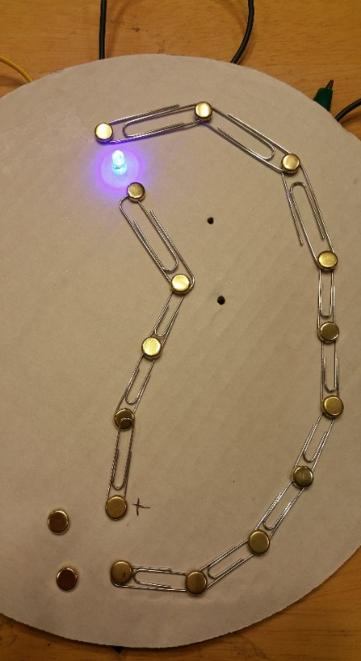
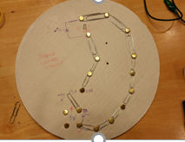
Circuit
A circuit is simply a closed loop through which charges can continuously move.

Slide 8
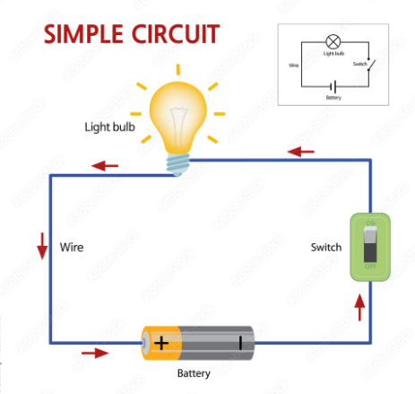
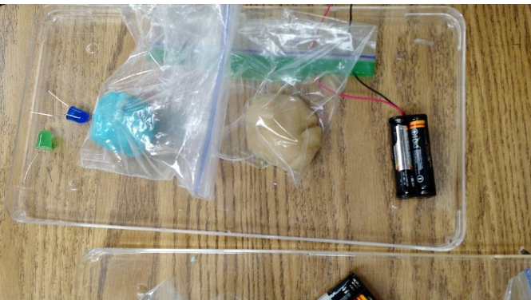
3 Centers
Simple Circuits
Squishy Circuits
Light Kit
Let’s explore electricity!

Slide 9
Vocabulary
Electric current—flow of electrical charges
Electrical charge—a property of matter concerning positively and negatively charged particles
Conductor—materials that let charges flow through them easily (copper, silver)
Insulator—materials that do not let charges flow easily (rubber, plastic, glass)
Circuit—path along which electric current flows (draw a picture)
Simple circuit—has 3 basic parts: power source, connectors, switch
Closed circuit—complete and unbroken, electricity flows through
Open circuit—has breaks or openings, so electricity does not flow through
Voltage—strength of power source

