Slide 1
Twin Oaks Elementary Science Docent Grade 5 States of Matter

Slide 2
Science Lab Rules
Please do not touch materials until instructed to do so
Never put any instruments or materials (liquid or solid) in your mouth, eyes, or ears. Or in the mouth, eyes, or ears of any student.
Take turns.
Listen carefully to the docent’s directions before you begin.
Handle all materials carefully
Relax and have fun

Slide 3
Student Tips
Wear safety glasses at all times.
Read all the directions first BEFORE starting
Measure all ingredients accurately
Clean the measuring spoons after each use.
Do not dip wet spoons into the dry ingredients.
Stir slowly and completely.
TBSP = Tablespoon
TSP = teaspoon
½ TSP + ½ TSP = 1 teaspoon
Borax and cornstarch are both white, select the correct one

Slide 4
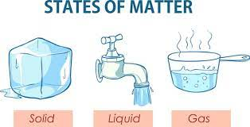
States of Matter
Physical States
Solid
Liquid
Gas
Molecules can move from one state to another

Slide 5
Changes of Matter
Physical Matter Change
When matter goes from a solid to a liquid
Energy force is the thing that causes the change when matter moves from one state to another
Water can change from liquid to solid and back over and over again
Chemical Matter Change
Occurs when a new substance is created
Molecules from original mixture bonded together and became new arrangement

Slide 6
Debrief - Takeaways
How do you know a chemical change occurred when you created the bouncy ball?
What happens to the molecules when a chemical reaction occurs?
What different kind of results did students get in the class?
more cornstarch - stretches and bends
less borax - goopier ball
more glue - slimmer ball
more borax - bouncier ball
Notes:
Where on Earth do earthquakes happen - Answer Earthquakes can occur anywhere
Where do most earthquakes occur - Around the boundaries of tectonic plates
What are engineers doing? - Answer - creating instruments for improved prediction and warning. Designing safer structures that can better resist earthquakes

Slide 7
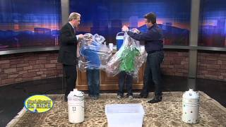
Videos
Steve Spangler Liquid Nitrogen Experiment

Slide 8
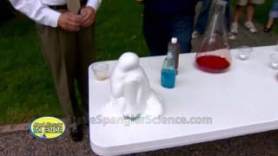
Videos
Steve Spangler Patriotic Elephant Toothpaste

Slide 9
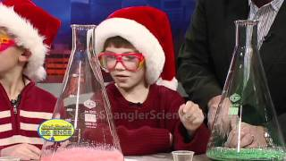
Videos
Steve Spangler Monster Foam

Slide 10
Vocabulary
Atom - The smallest particle of an element that has the properties of that element.
Element - A pure substance that cannot be broken down into any simpler substances.
Molecule - A particle that contains two or more atoms joined together. (Example: Oxygen)
Mixture - A physical combination of two or more substances that does not form a new substance. (Example: muddy water, trail mix)
Suspension - A mixture whose visible particles settle and separate over time.
Solution - A mixture that is blended so completely that it looks the same everywhere. (Example: sugar dissolved into water)
Solvent - The substance in a solution into which other substances dissolve. (In salt water, salt is the solute)
Solute - The substance is a solution that dissolves. (In salt water, salt is the solute.)
Solubility - The greatest amount of a solute that can be dissolved by a solvent.

