Slide 1
Twin Oaks Elementary Science Docent Grade 4 Earth Science: Earthquakes

Slide 2
Science Lab Rules
Please do not touch materials until instructed to do so
Never put any instruments or materials (liquid or solid) in your mouth, eyes, or ears. Or in the mouth, eyes, or ears of any student.
Jello cups and extra marshmallows have been set aside for students that avoid eating experiment materials.
Take turns.
Listen carefully to the docent’s directions before you begin.
Handle all materials carefully
Relax and have fun

Slide 3
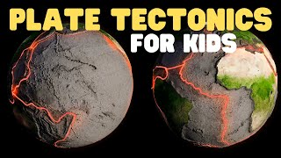
What causes Earthquakes?
Watch video 7:22

Slide 4
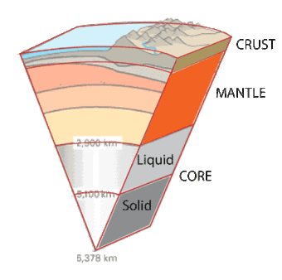
Earth’s Layers
Earth has four major layers
Inner core
Outer core
Mantle
Slow moving
Crust
Many puzzle pieces called tectonic plates
Notes:
The Mantle
This layer of rock even flows like asphalt under a heavy weight. This flow is due to great temperature differences from the bottom to the top of the mantle. The movement of the mantle is the reason that the plates of the Earth move. https://volcano.oregonstate.edu/earths-layers-lesson-1#:~:text=The%20Mantle,-The%20mantle%20is&text=This%20layer%20of%20rock%20even,plates%20of%20the%20Earth%20move!
Earthquake is what happens when two blocs of earth suddenly slip past one another
The fault or fault plane is the surface where they slip.
The hypocenter is the location below the earth’s surface where the earthquake starts.
The epicenter is the location directly above the hypocenter on the earth’s surface.

Slide 5
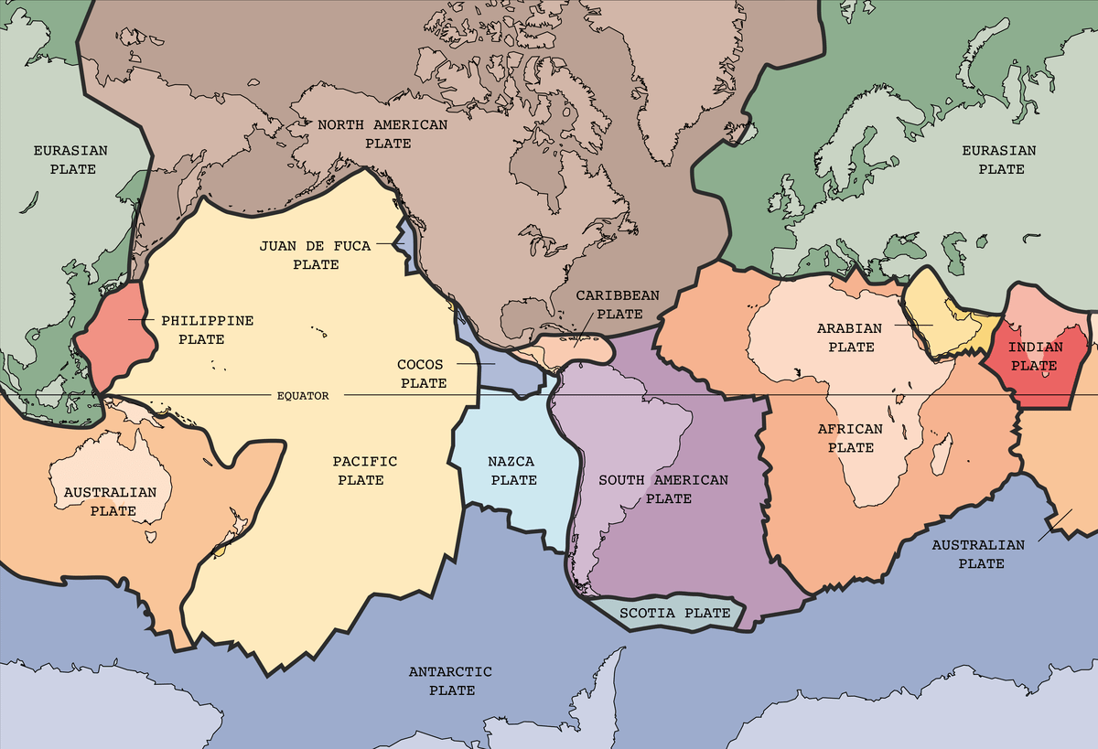
Tectonic Plates
Tectonic plates are puzzle pieces of Earth’s crust
Faults are the borders of the tectonic plates
Edges of plates are rough and can get stuck
Earthquakes happen when edges unstick
Energy radiates in all directions like
ripples in a pond called seismic waves
Notes:
Southern California has more than 300 active faults, most of which are part of the San Andreas Fault system.
The 800 miles long San Andreas fault forms the tectonic boundary between the North American and Pacific tectonic plates.
The San Andreas fault line in California is the longest in the world. It sits between the Pacific and North American plates and measures 1300kms
A fault is a crack in the Earth's lithosphere (crust and upper mantle layers) that occurs between two pieces of rock. Rock pieces are able to move at a fault, meaning earthquakes can occur if the movement pushes those rock pieces into or past one another.
Earthquakes occur along fault lines, cracks in Earth's crust where tectonic plates meet. They occur where plates are subducting, spreading, slipping, or colliding. As the plates grind together, they get stuck and pressure builds up. Finally, the pressure between the plates is so great that they break loose. https://www.amnh.org/explore/ology/earth/power-of-plate-tectonics/earthquakes

Slide 6
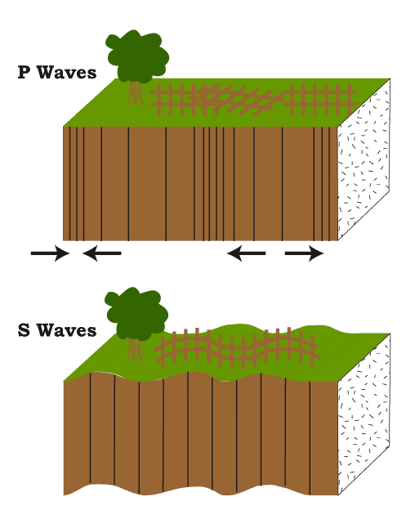
Types of Seismic Waves
Primary or P waves travel fastest
and are the first to arrive
Secondary or S waves follow P waves
and take longer to get to you
Looking at time between waves
tells you how far away the epicenter
was
Notes:
P waves The first wave to hit seismographs, Can move through solids and liquids
S waves Second waves to hit seismographs, Can only move through solids, are stronger and more destructive than P waves

Slide 7
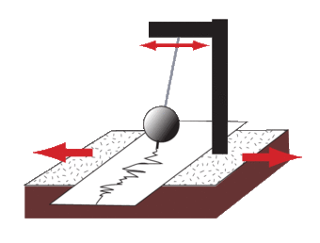
How Are Earthquakes Recorded?
Seismographs record earthquakes
Size of the earthquake depends on size of the fault and the amount of slip on the fault
Two scales
Richter Scale - Magnitude
Mercalli Scale - Intensity

Slide 8
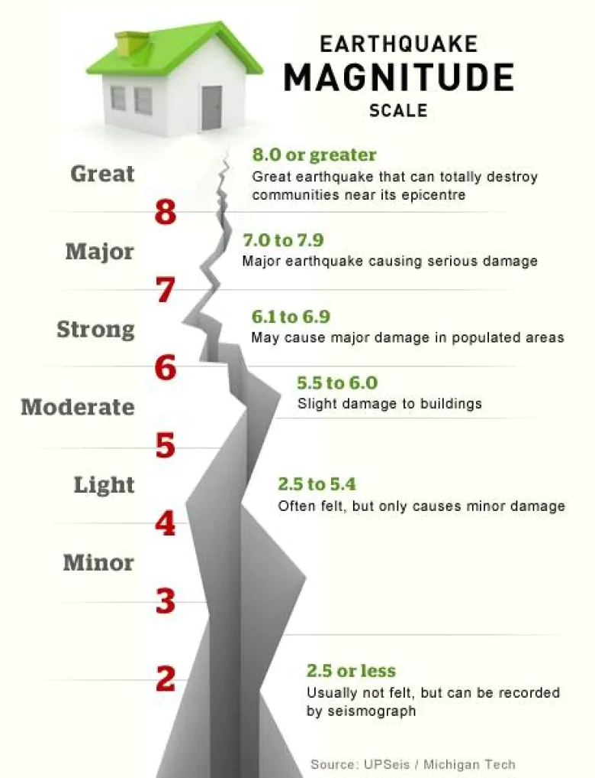
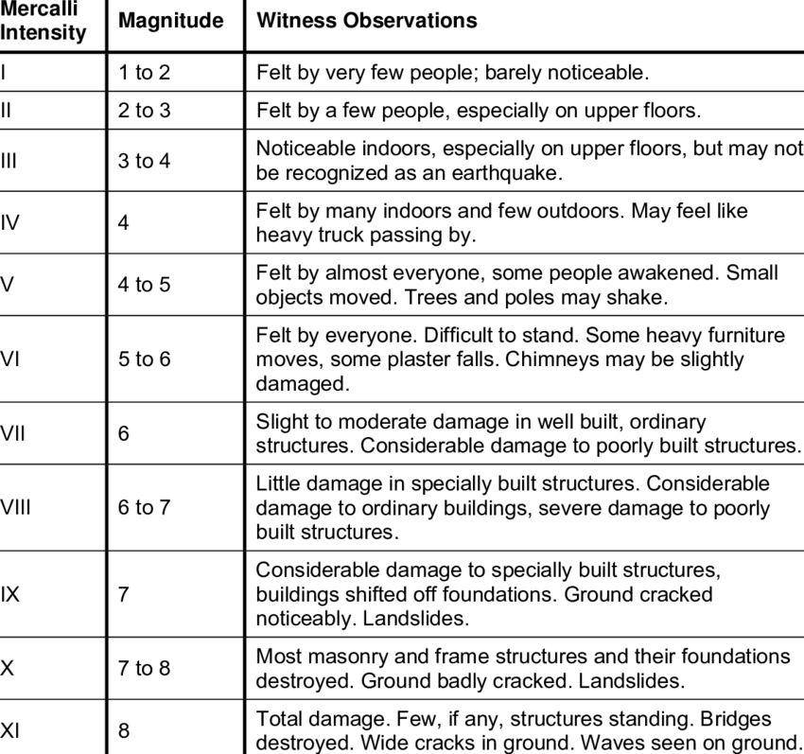
Richter and Mercalli Scales
Notes:
May 11, 2023, a magnitude 5.5 quake centered in the Sierra Nevada's Lake Almanor resort region struck at 4:19 p.m. Thursday and a magnitude 5.2 aftershock occurred at 3:18 a.m. Friday, according to the U.S. Geological Survey.

Slide 9
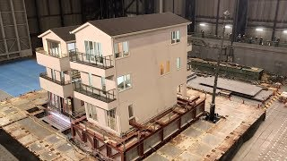
Real Life Shake Tables
Watch video 2:13
Notes:
We will be working with our own real life shake tables today.

Slide 10
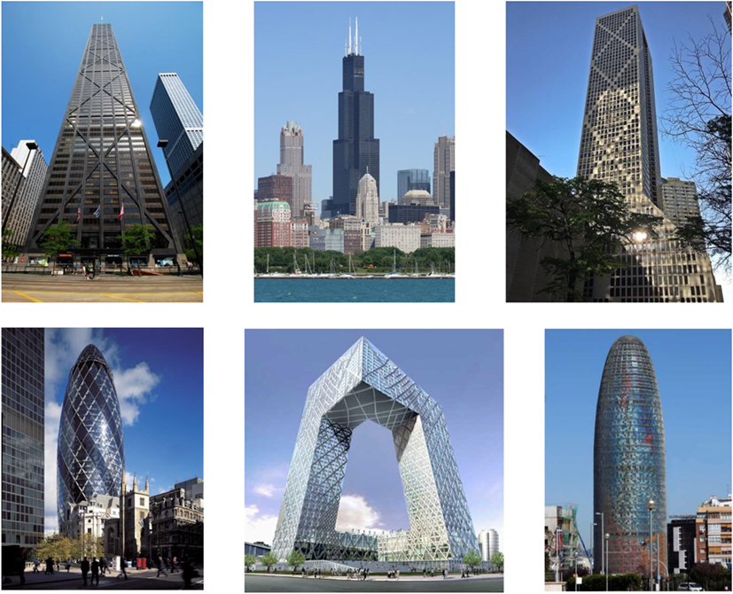
Notes:
Here are some samples of skyscrapers.

Slide 11
Earthquake Experiment
Today you will be engineers
Materials
30 toothpicks
30 marshmallows
Building Requirements
Must be at least two toothpick levels high

Slide 12
Engineering Process
Notes:
Engineers ask critical questions about what they want to create and what problem they are trying to solve. What are the requirements? What are the limitations? Engineers then imagine possible solutions. They make a list of solutions and sketches. The team engineers a plan and selects best idea. They create prototypes and test it out. See what needs to be changed and improve. You will become engineers today

Slide 13
Earthquake Experiment
Start by designing a building on paper
Squares or cubes
Triangles
Use full size or broken toothpicks
May use cross bracing
Then build building on desk
Next place building on Jello pan
Finally, tap pans to simulate S or secondary/a seismic wave

Slide 14
Earthquake Experiments
How did your building do?
What could you do to make stronger
Should you make base bigger
Structure taller or smaller
Redesign and test again
What worked best, why?

Slide 15
Debrief - Take Aways
How did your structure survive the earthquake?
Are all earthquakes the same strength?
How do we measure earthquakes?
Where on earth do earthquakes happen?
Where do most earthquakes occur?
What are engineers doing to help?
Notes:
Where on Earth do earthquakes happen - Answer Earthquakes can occur anywhere
Where do most earthquakes occur - Around the boundaries of tectonic plates
What are engineers doing? - Answer - creating instruments for improved prediction and warning. Designing safer structures that can better resist earthquakes

Slide 16
Vocabulary
Fault: A crack in the rock, caused by movement of the Earth’s crust
Focus: The point under the surface of the Earth where an Earthquake begins.
Megathrust: An earthquake that occurs when one tectonic plate subducts beneath another. Megathrust earthquakes often generate large tsunamis that cause damage over a much wider area.
Mercalli scale: A scale from I to XII that measures the amount of damage sustained in an earthquake
P waves: Primary body waves, which travel from the focus of an earthquake. These are compression waves.
Richter scale: A scale from 1 to 9 that measures the strength of an earthquake
S waves: The slower secondary body waves that cause side to side movement.

Slide 17
Vocabulary
Seismogram: A zigzag line created by vibrations read from a seismograph caused by body waves
Seismograph: An instrument that measures how much the ground shakes or vibrates in an earthquake
Tectonic plate: Section of the Earth’s crust
Tsunami: A series of ocean waves generated by an rapid large-scale disturbance of the sea water. Most tsunamis are generated by earthquakes, bute they may also be caused by volcanic eruptions, landslides, undersea slimps or meteor impacts.

